Slide 1
CENG-232 Logic Design
Combinational Design Examples

Slide 2
Example: majority circuit
Design a 4-input majority circuit. A majority circuit outputs 1 if the input variables have more 1’s than 0’s.
A B C D F
0
0
0
0
0
0
0
0
1
1
1
1
1
1
1
1
0
0
0
0
1
1
1
1
0
0
0
0
1
1
1
1
0
0
1
1
0
0
1
1
0
0
1
1
0
0
1
1
0
1
0
1
0
1
0
1
0
1
0
1
0
1
0
1
0
0
0
0
0
0
0
1
0
0
0
1
0
1
1
1
AB
CD
00
01
11
10
00
01
1
11
1
1
1
10
1
F = ABD + BCD + ABC + ACD
Notes:
ABD + BCD + ABC + ACD

Slide 3
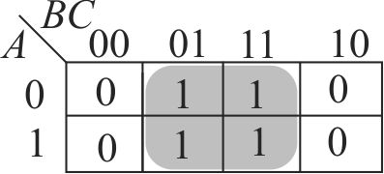
Example
Design a combinational circuit with 3 inputs and 1 output such that the output is 1 when the binary value of the inputs is an odd number.
F(A, B, C) = C

Slide 4
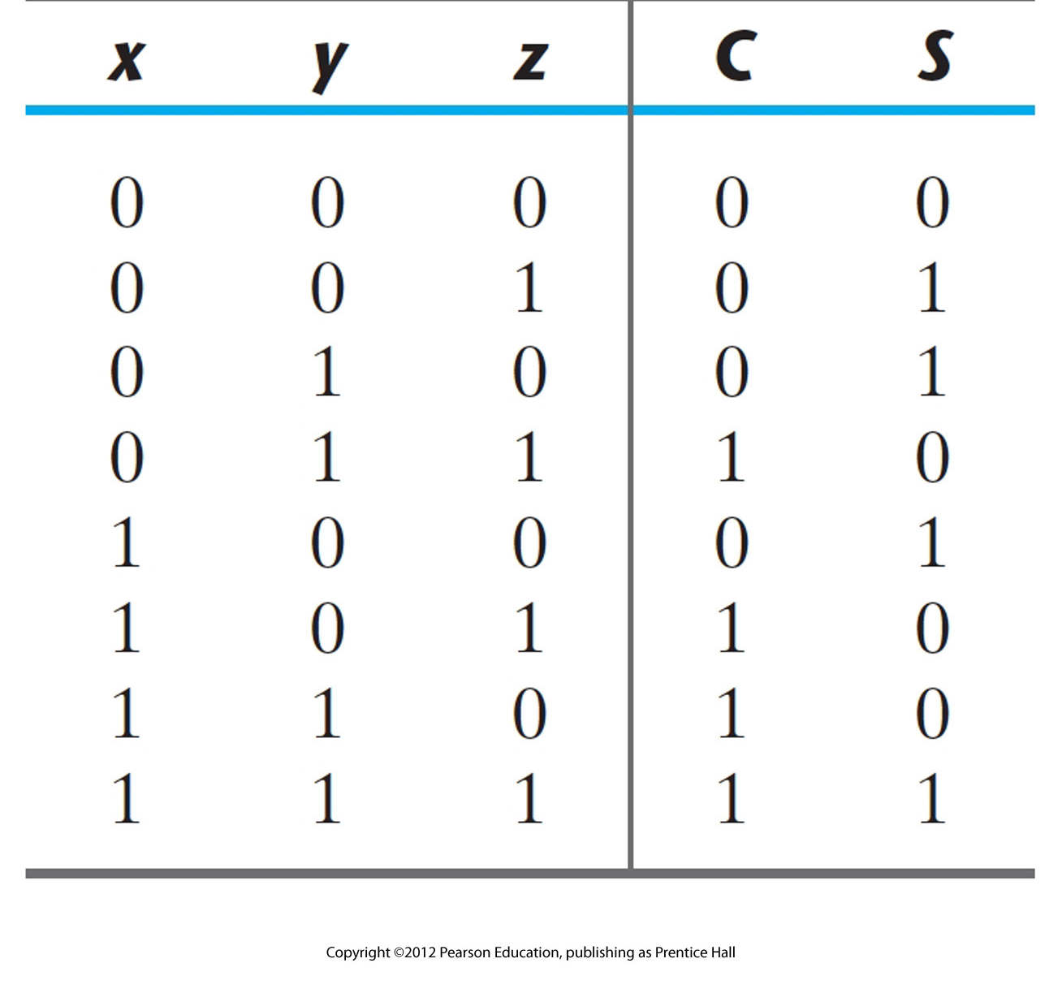
Example
Design a full adder : add 3 bits and produce 2 bit output for sum an carry.

Slide 5
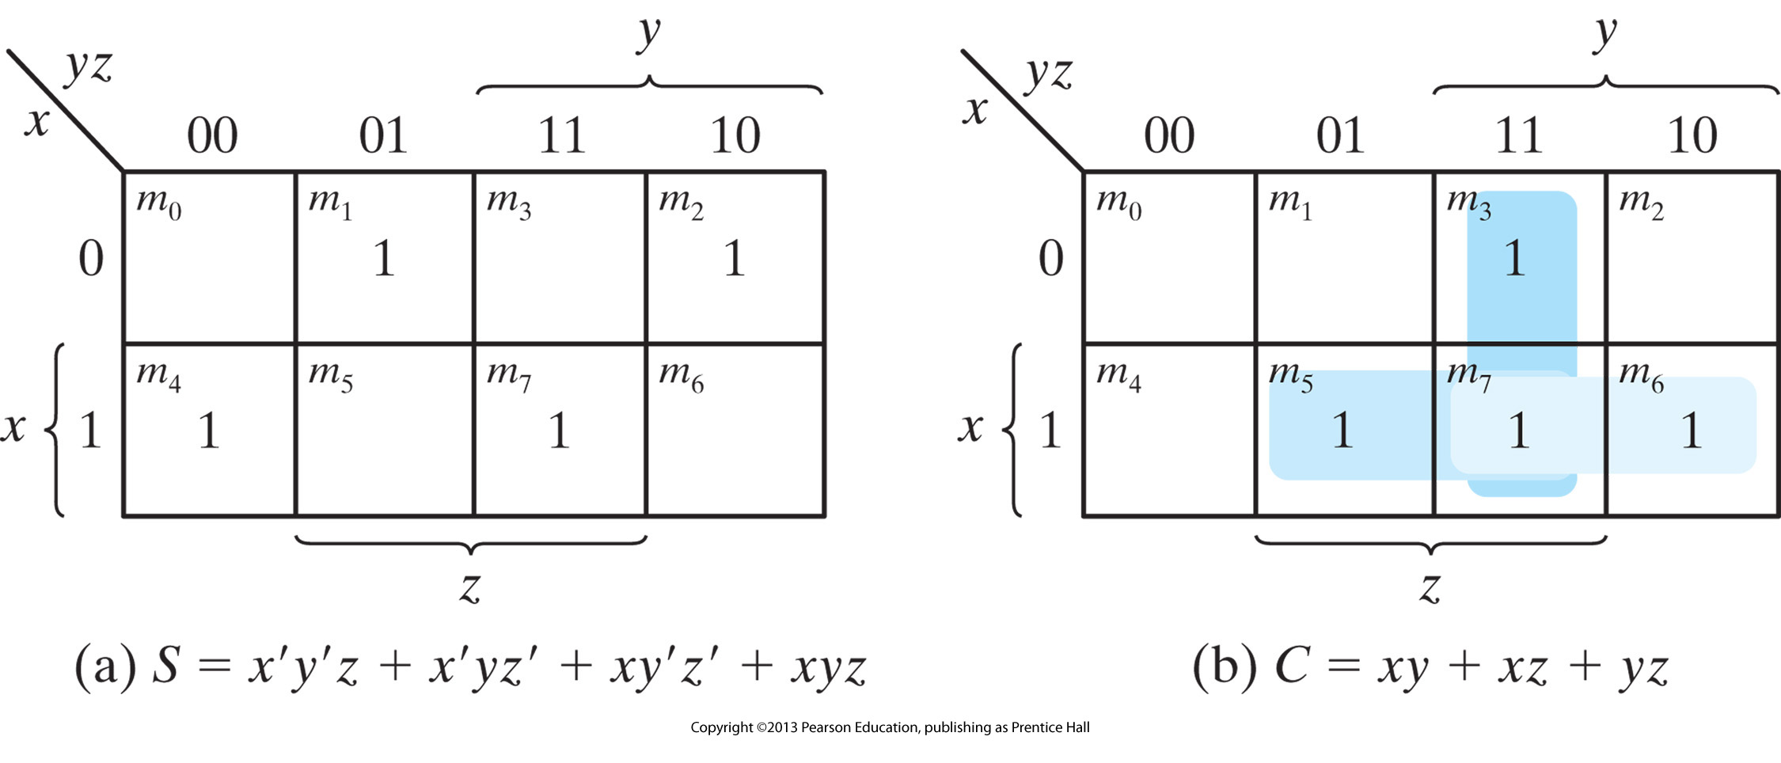

Slide 6
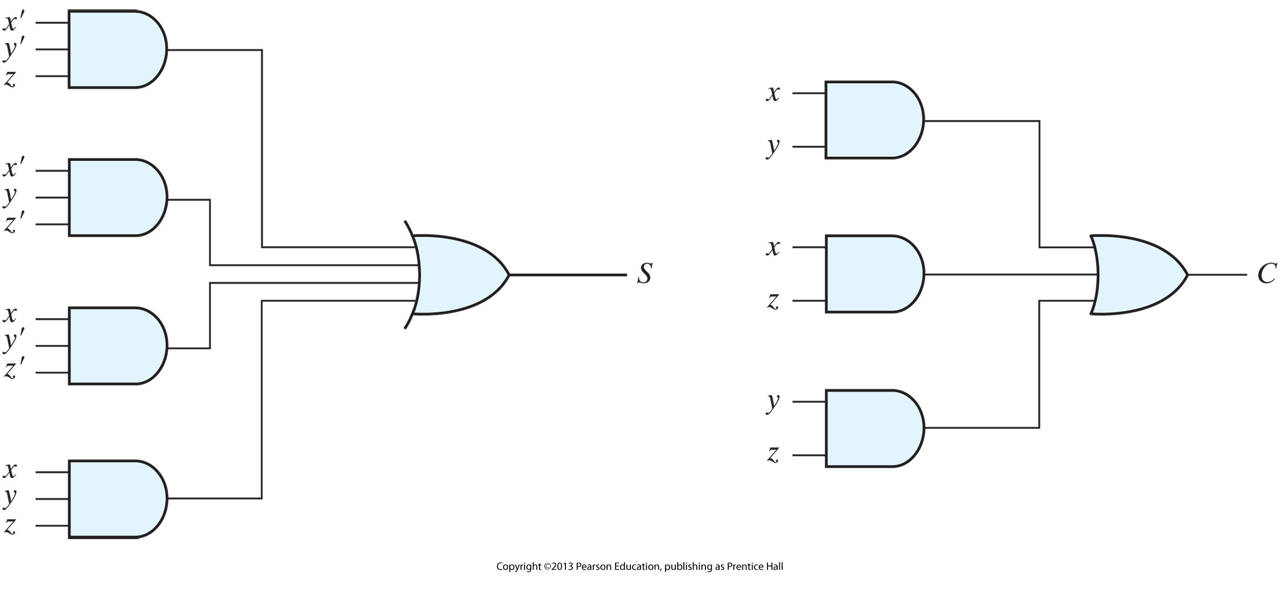

Slide 7
Design a circuit that has a 3-bit binary input and a single output that outputs 1 if it is a prime number.

Slide 8
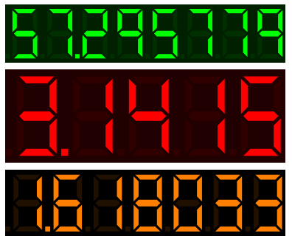
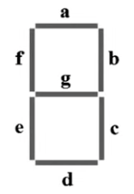
7 Segment Display

Slide 9
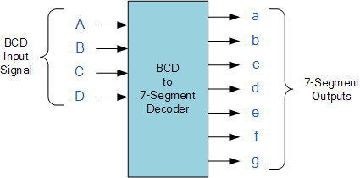
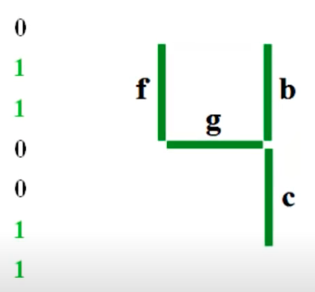
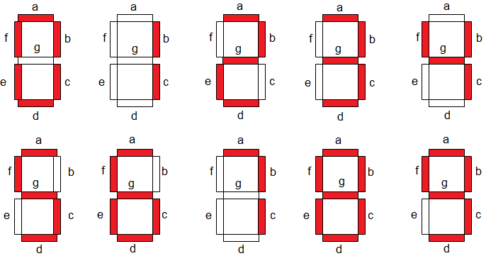
Design this circuit

Slide 10
Don’t forget the unused combinations

Slide 11
AB
CD
00
01
11
10
00
01
11
10

